Slide 1
Advanced Database Management
Topic
Financial Market Data Analysis
Team Members
Tushar Yadav
Dhruti Dilipbhai Patel

Slide 2

Problem Statement
Analyzing Market Data from Alpha Vantage API for Investment Insights
Background
The financial markets generate a vast amount of data, which can be leveraged for making informed investment decisions. The provided data source provides access to historical and real-time market data, including stock prices, indices, and other financial instruments. In this project, we aim to utilize this data for real time analysis and predictive analysis of the market.

Slide 3
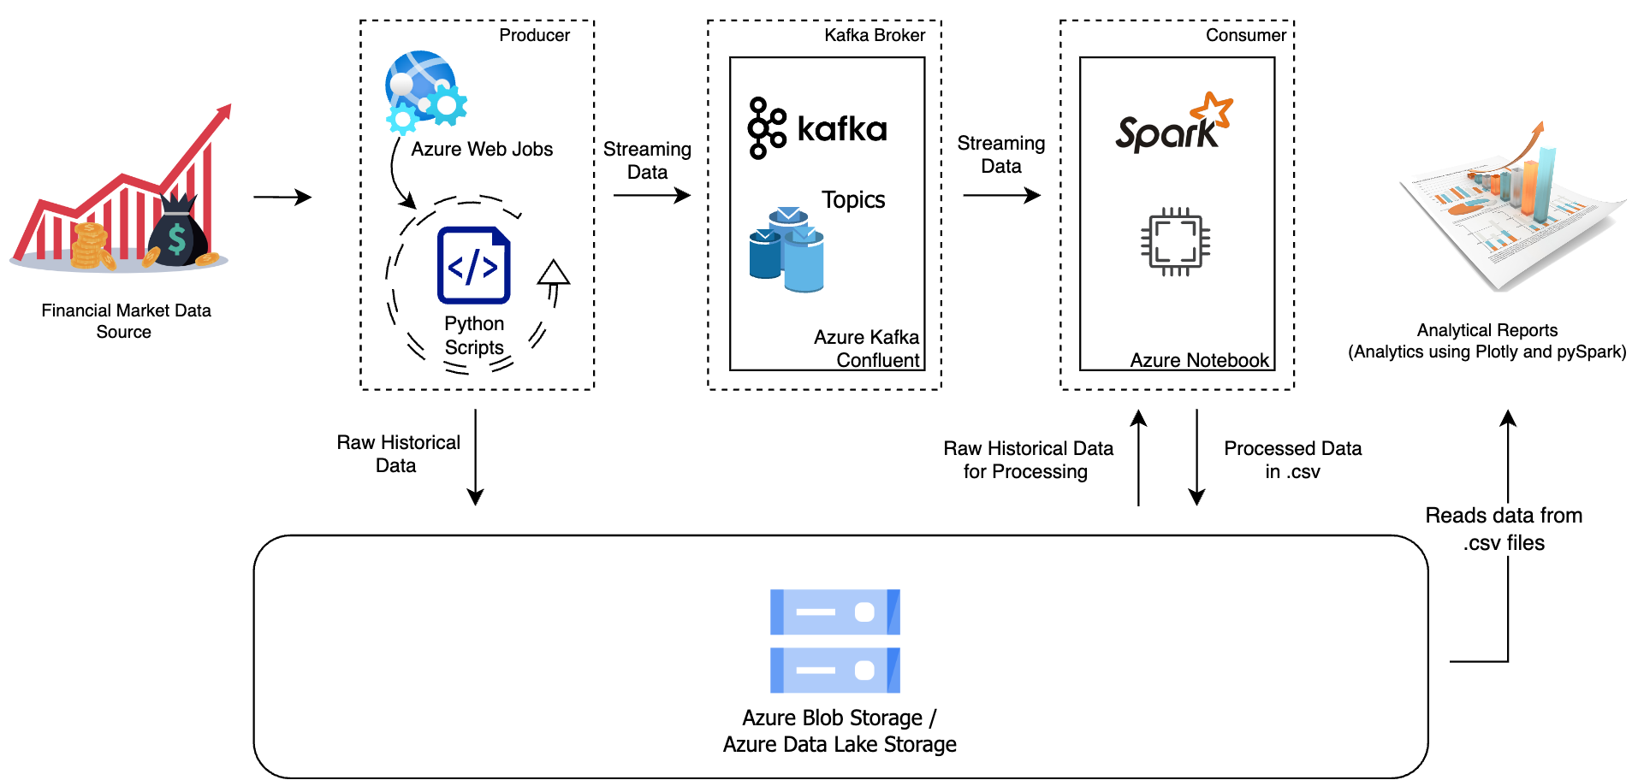
Architecture Design

Slide 4
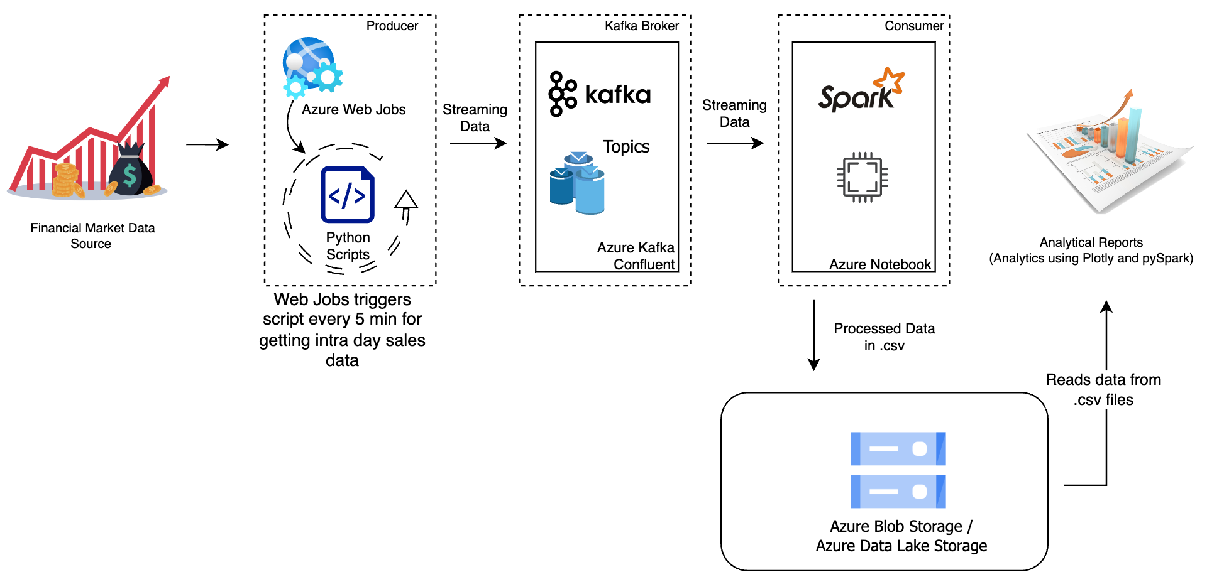
Data Flow 1: Streaming Data

Slide 5
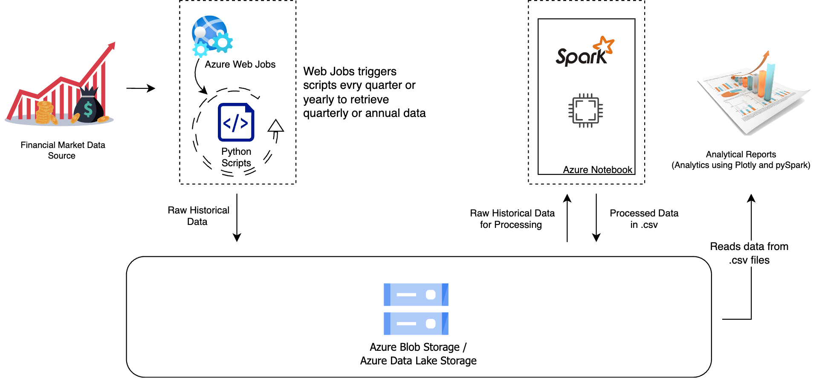
Data Flow 2: Historical Data

Slide 6
Architecture Design
Financial Market Data API
This component represents the external API we are using to fetch financial market data. For this we are using Alpha Vantage APIs.
Python Script
A Python script or application responsible for making API requests, retrieving streaming data and historical data periodically as triggered by Azure Web Jobs, and potentially transforming it. For streaming data instead of saving the data locally, it processes and sends the data to Apache Kafka topics but sends the historical data directly into Azure Blob Storage.
Apache Kafka
Kafka receives the streaming data from the Python Script and acts as a message broker. It stores the data temporarily and allows multiple consumers (e.g., Spark, other applications, etc.) to subscribe to and process the data.
Apache Spark
Apache Spark will be used for more complex data processing, analysis, and transformation. It can read data from Kafka and perform real-time or batch processing as needed and also grab historical data from data storage and process data.

Slide 7
Architecture Design
Azure Storage Solutions (Blob Service/ Data Lakes)
This component represents the external API you're using to fetch financial market data. For this we are using Alpha Vantage.
Data Processing and Analysis
Perform the necessary data processing and transformations on the market data. You can use Spark's powerful APIs to filter, aggregate, join, and manipulate the data as needed for your analysis.
Analytics and Representation
This layer is the dashboard or presentation layer where we try to understand and analyze the final processed data using graphs and charts.
Apply the specific analysis or algorithms you need for your financial market data. This can include calculating various financial metrics, identifying patterns, or building predictive models.

Slide 8

DATASOURCE
Alpha Vantage API
This suite of APIs provide global equity data in 4 different temporal resolutions:
Daily
Weekly
Monthly
Intraday
This source also provides 20+ years of historical depth and has a service that returns the latest price and volume information for a ticker of your choice.

Slide 9
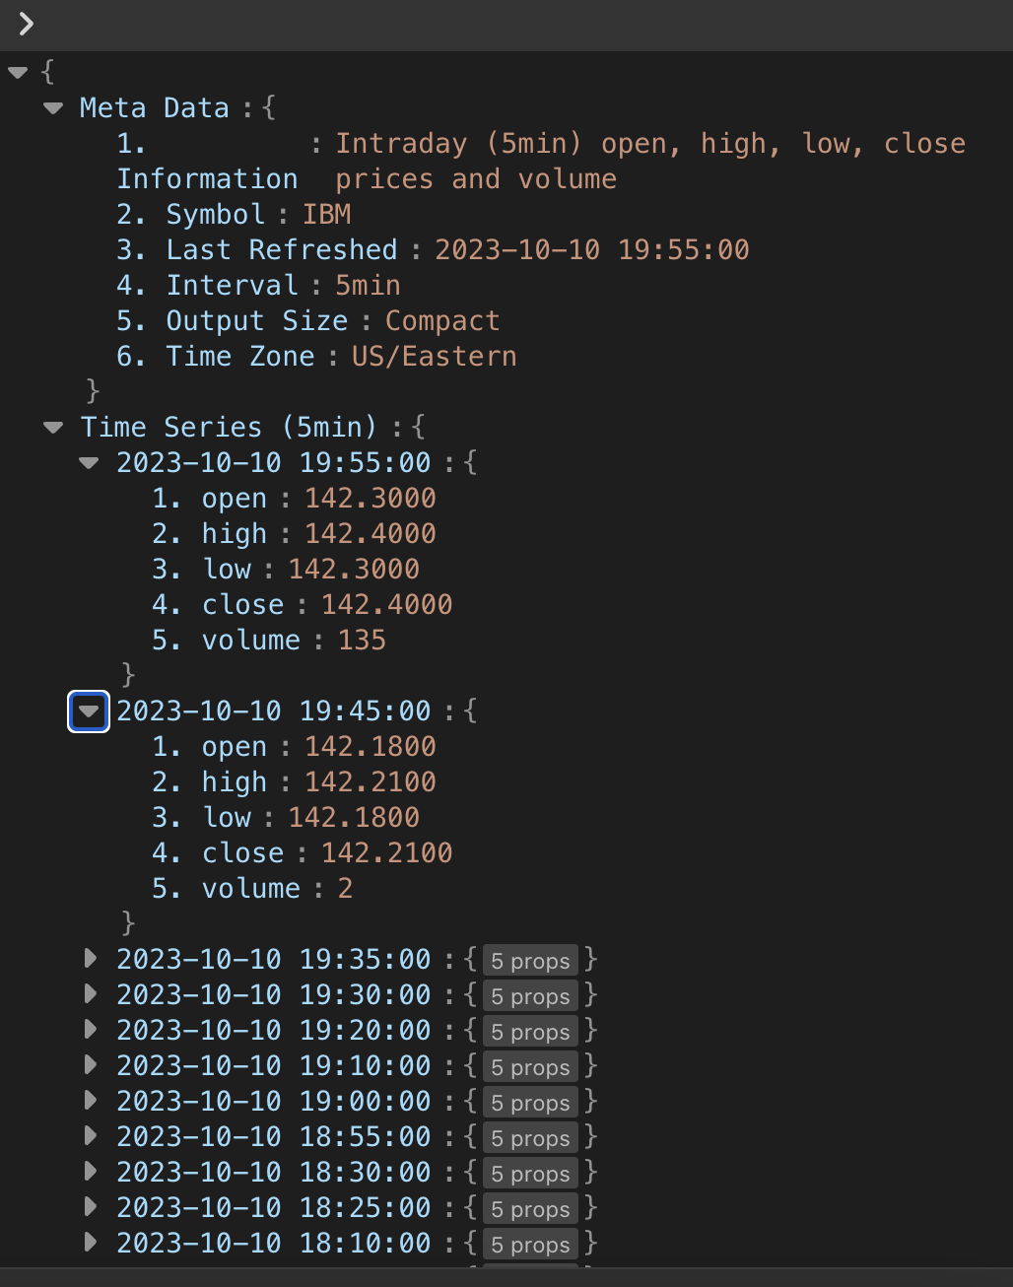
Streaming Data
SAMPLE DATA

Slide 10
Historical Data
SAMPLE DATA

Slide 11
Analysis
We are considering two types of analysis based on our implementation, utilizing both real-time streaming data, which updates frequently throughout the day, and historical data spanning over 25 years.
Trading Patterns using Line Charts and Histograms
Price Trends: Line charts allow us to visualize historical price movements over time.
Support and Resistance Levels: By plotting key price levels over time, we can spot critical support and resistance areas, which are pivotal for setting stop-loss and take-profit orders.
Moving Averages: Line charts assist in plotting moving averages, such as the simple moving average (SMA) and the exponential moving average (EMA). These indicators help identify trends and potential crossovers.
Market Predictive Analysis using Machine Learning
Time Series Forecasting: Predict future stock prices or market trends based on historical data. Utilize time series forecasting models such as ARIMA (AutoRegressive Integrated Moving Average), GARCH (Generalized Autoregressive Conditional Heteroskedasticity), or more advanced models like LSTM (Long Short-Term Memory) neural networks.
Pattern Recognition: Identify and act upon specific technical chart patterns.

Slide 12
REFERENCES
https://learn.microsoft.com/en-us/azure/architecture/
https://spark.apache.org/docs/latest/
https://kafka.apache.org/uses
https://www.alphavantage.co/documentation/#

